Slide 1
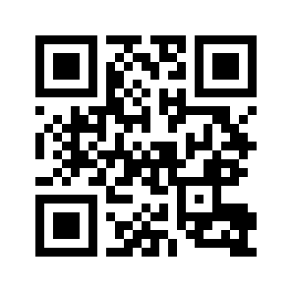
Fill in Attendance — edu.nl/pmc78
Warm-up Activity:
Spot the mistake. Correct each sentence on your worksheet.
1. Although the rain, we went out.
2. My teacher, that is very kind, helped me.
3. If I would have money, I would travel.

